Slide 1
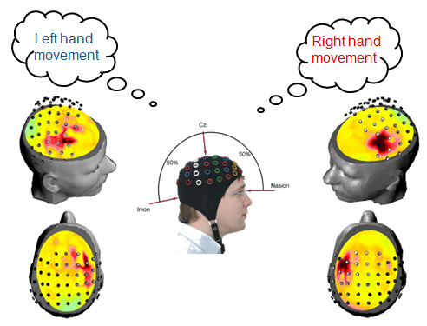

Pattern Recognition and Machine Learning TERM PROJECT
Classification of the Motor Imagery
2017.6.14
In-Nae Wang
Hyung-Joon Moon
Yong-Jeong Kim

Slide 2

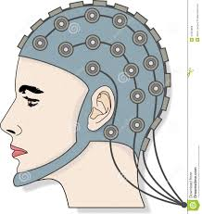
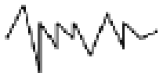

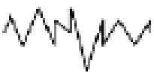
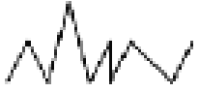
I. Introduction
Introduction
Goal
Classifying the 2-Class Motor Imagery (MI) through various methods
CSP-LDA, CNN, Logistic Regression
Background
Motor Imagery
Mental process by which an individual rehearses or simulates a given action
Ch 1
Signal processing
OR
Ch 2
…
…
Ch N

Slide 3
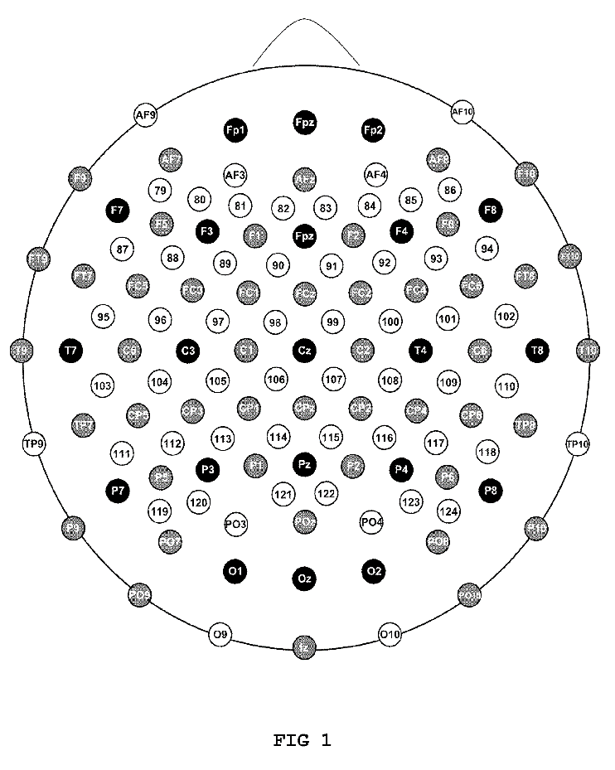
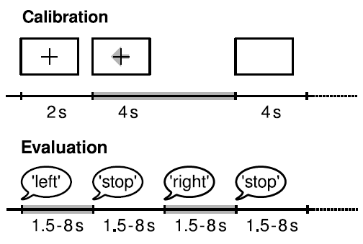
I. Introduction
Dataset : from BCI Competition III
BCI competition III_4a
5 subjects who performed right-hand and foot imagination
280 trials of EEG measurements from 118 electrodes
Selected 19 channels
Motor area: 19 channels (FC5, FC3, FC1 Etc)
Segmentation which is starting from 0.5s to 3.5s after the visual cue
10×10-fold cross-validation
EEG channels used in classification
Motor Imagery recording procedure

Slide 4
II. Methods & Results
Our Approaches for Classification
LDA
1D Conv-Net
2D Conv-Net with Spectrogram
Logistic Regression

Slide 5
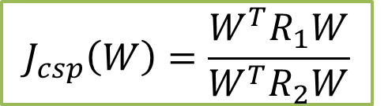
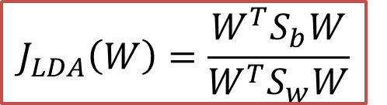
II. Methods & Results
1. LDA
Standard way to analyze EEG data
Band-Pass Filter (BPF): 8~30 Hz
Common Spatial Pattern (CSP)
Maximizing the ratio for covariance of two tasks
Linear Discriminant Analysis (LDA)
Maximizing the between-covariance Minimizing the within-covariance
$$J_{csp}\left(W\right)=\frac{W^{T}R_{1}W}{W^{T}R_{2}W}$$
$$J_{LDA}\left(W\right)=\frac{W^{T}S_{b}W}{W^{T}S_{w}W}$$
BPF: 8~30 Hz
(Preprocessing)
CSP -> logvar
(Feature Extraction)
LDA (Classification)
EEG Raw Signals

Slide 6
III. Results
1. LDA (Results)
Avg. 88% classification performance
Showed High Energy around 10Hz
The classification results of LDA
Subject | Right Hand vs Foot
aa | 0.82
al | 0.97
av | 0.72
aw | 0.95
ay | 0.95
Avg. | 0.88
Time-freq. representation for right-hand motor imagery

Slide 7
III. Results
1. LDA (Reference)
Analysis of the spatial filter & pattern
Filter
Pattern
Filter
Pattern
Right
Foot
Subject: 3
Subject: 5

Slide 8
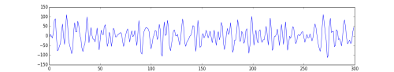
III. Results
2. 1D Conv Net
Our Architecture Over view
19 Channel
time
280 trial
EEG Data
Array Structure

Slide 9
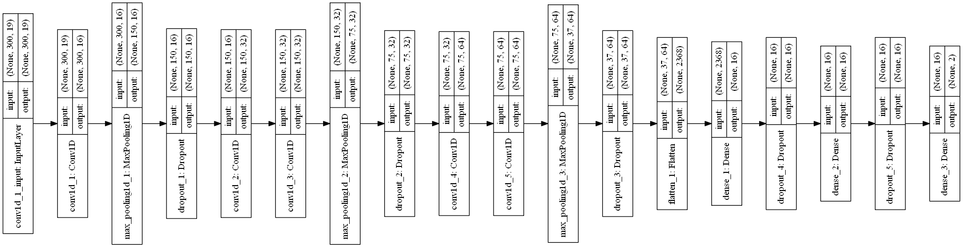
III. Results
2. 1D Conv Net
For Deeper Conv Net in Small DATA, We Tried,
Parameter dimension control : 15k ~ 30k
1 x 1 layer to reduction of features
Kernel initializer : He-Uniform
Activation : Leaky Relu
So…deep. Will this work?

Slide 10
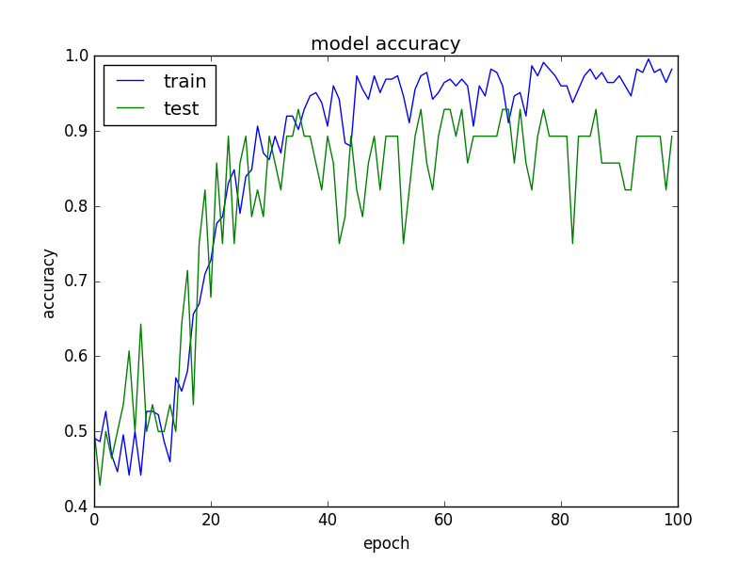
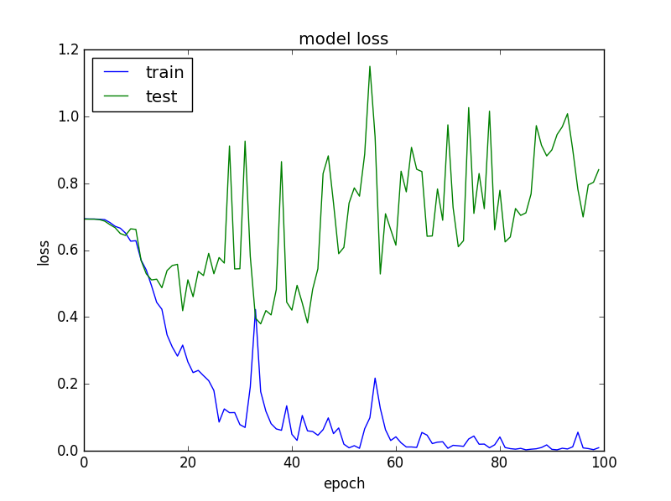
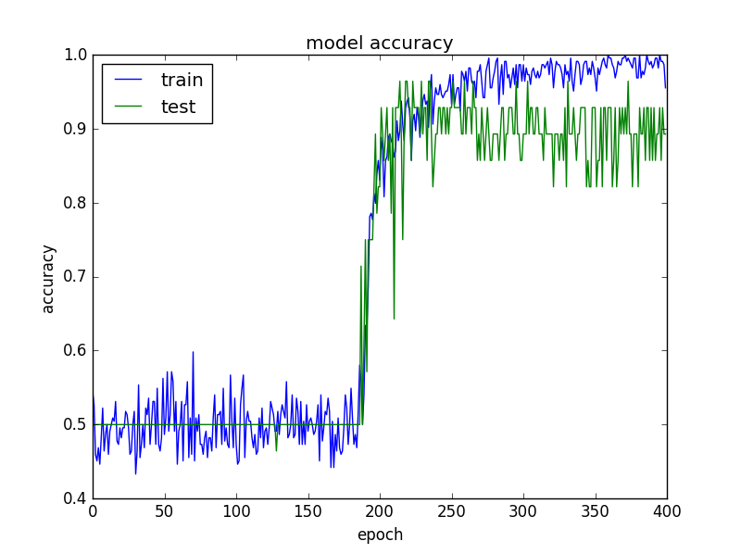
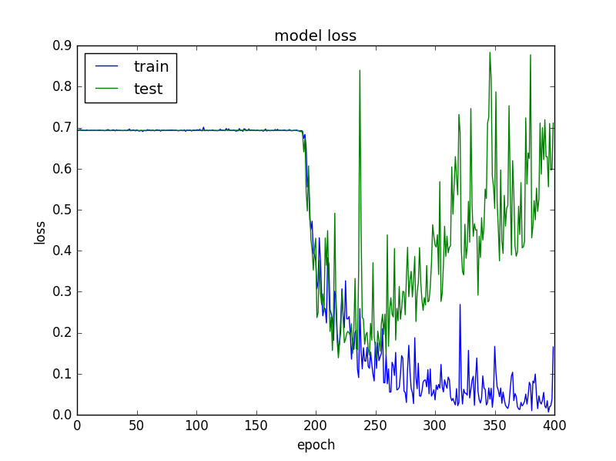
III. Results
2. 1D Conv Net (Results)
In Not so Deep
Early Stop
In very Deep
Early Stop

Slide 11
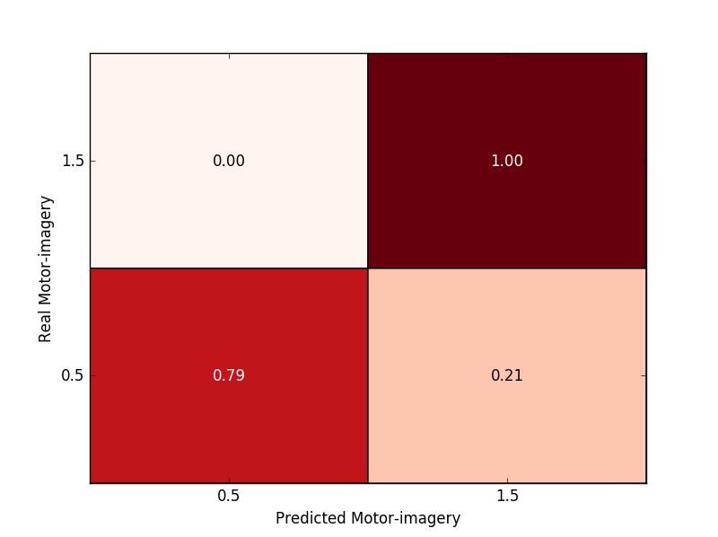
III. Results
2. 1D Conv Net (Results – 10fold cross valid.)
It worked quite well, but not not satisfied. (failed in subj 3)
Confusion Matrix for one sample test-set
The classification results of 1D Conv
Subject | Right Hand vs Foot
aa | 0.86
al | 0.95
av | -
aw | 0.95
ay | 0.90
Avg. | 0.91 (?)

Slide 12
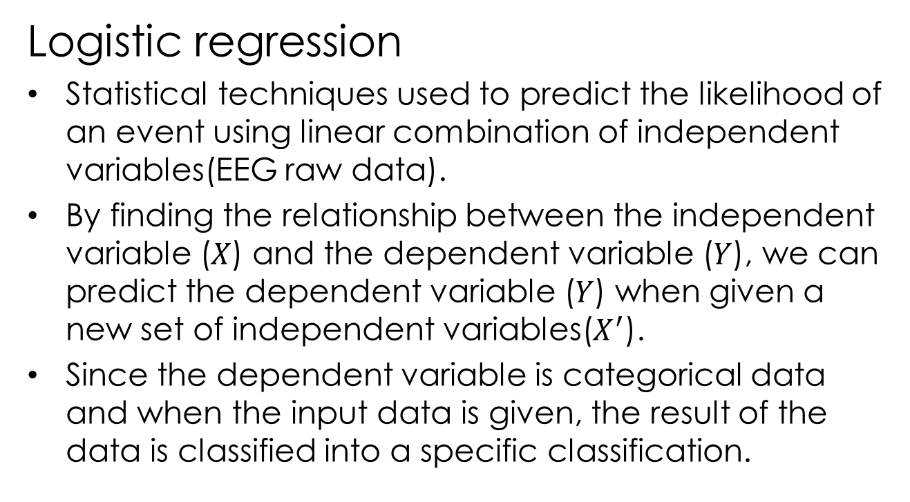
III. Results
3. Logistic regression
Logistic regression
Statistical techniques used to predict the likelihood of an event using linear combination of independent variables(EEG raw data).
By finding the relationship between the independent variable (𝑋) and the dependent variable (𝑌), we can predict the dependent variable (𝑌) when given a new set of independent variables($X^{′}$).
Since the dependent variable is categorical data and when the input data is given, the result of the data is classified into a specific classification.

Slide 13
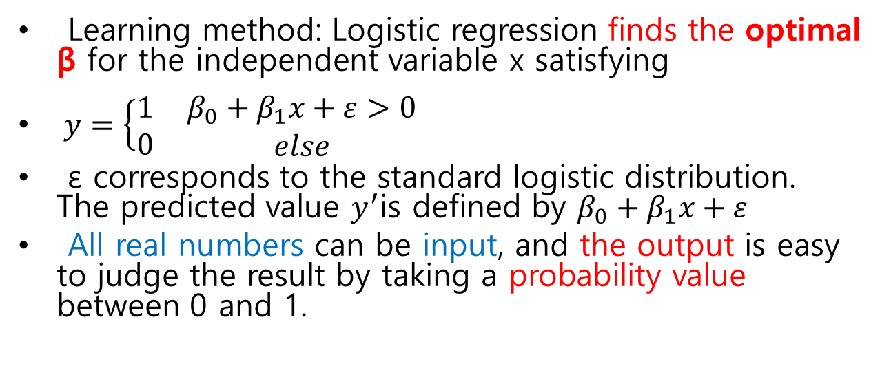
III. Results
3. Logistic regression
Learning method: Logistic regression finds the optimal β for the independent variable x satisfying
$y=\left\{\begin{matrix}1 \\ 0\end{matrix}\right. \begin{matrix}β_{0}+β_{1}x+ε>0 \\ else\end{matrix}$
ε corresponds to the standard logistic distribution. The predicted value $y^{′}$is defined by $β_{0}+β_{1}x+ε$
All real numbers can be input, and the output is easy to judge the result by taking a probability value between 0 and 1.

Slide 14
Thank you

